Slide 1


Just Sustainability Transitions Perspective on Social Innovations in Energy
Dr. Flor Avelino
Associate Professor, Erasmus University Rotterdam
avelino@drift.eur.nl
@FlorAvelino
date / location
14.09.21
SMARTEES final conference
ONLINE

Slide 2
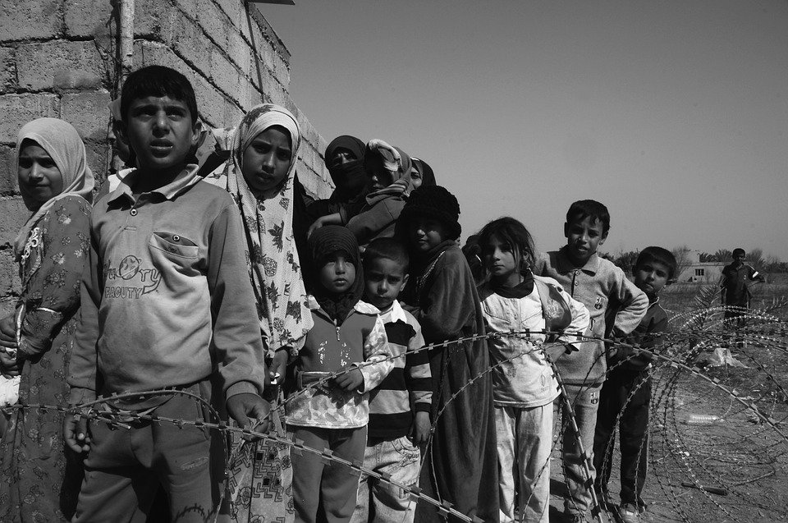

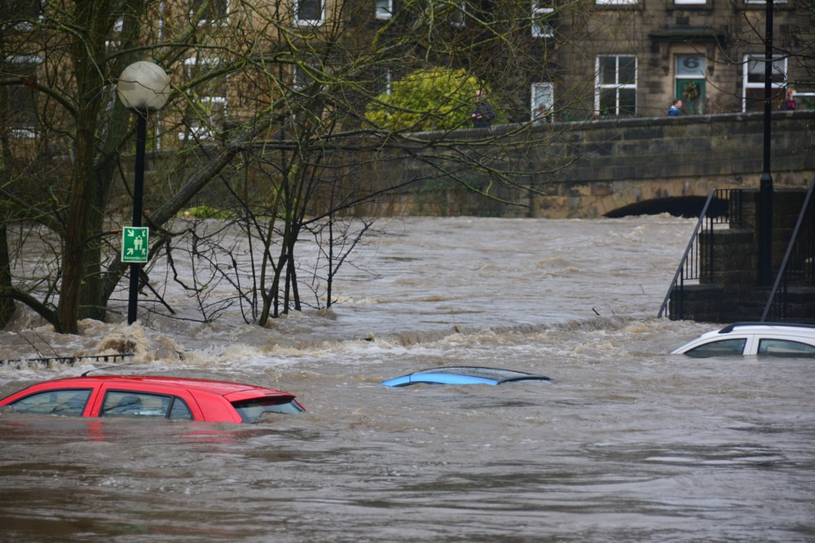

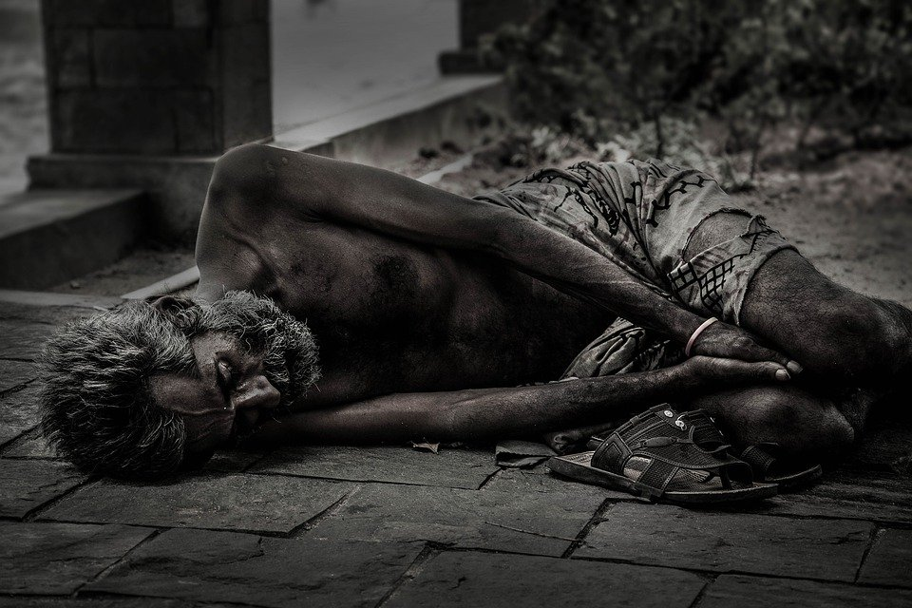
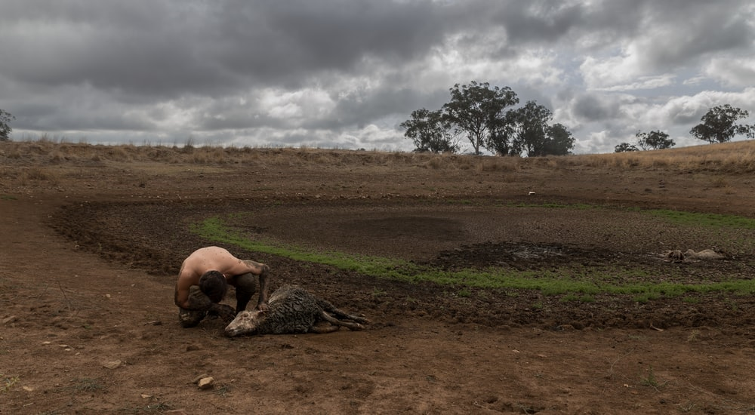
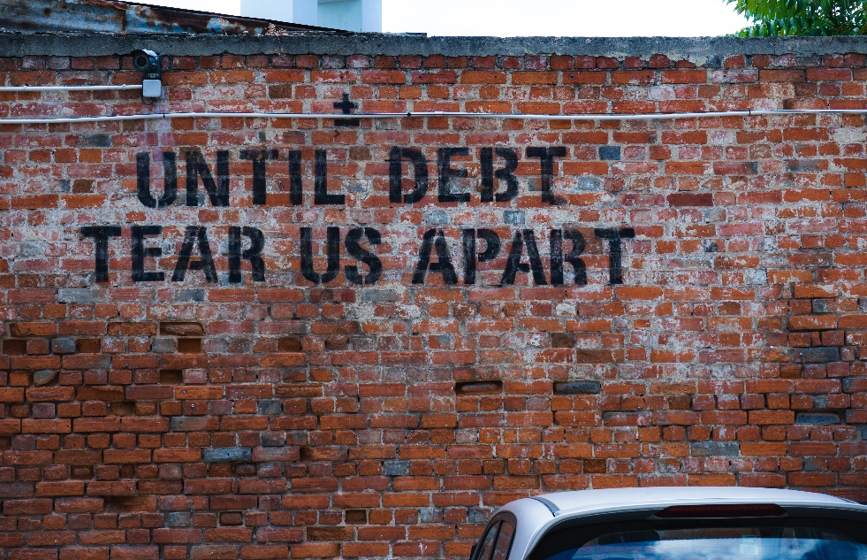

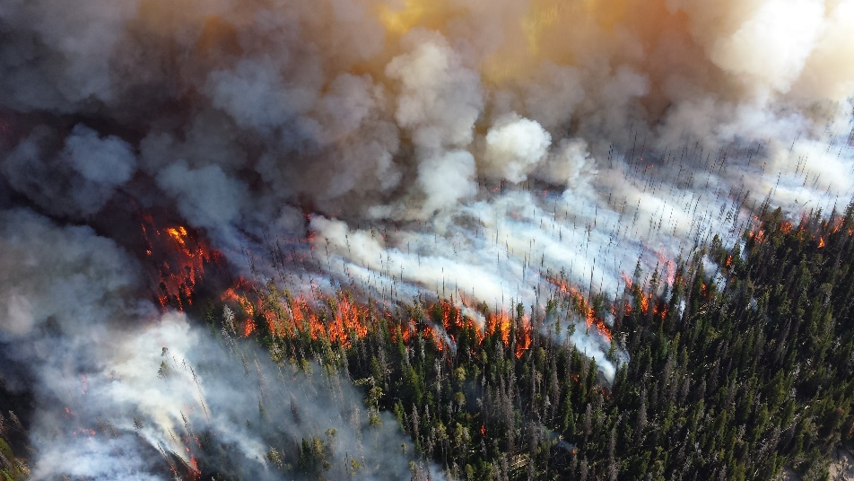
To tackle societal challenges,
innovation is necessary, but not sufficient.
We need systemic, transformative change,
i.e. transitions towards more just & sustainable societies.
Photo by Chris Gallagher on Unsplash
Image from Pixabay
Image from Pixabay
Photo by Jasper Wilde on Unsplash
Image by rostichep from Pixabay
Image by Kasun Chamara from Pixabay
Image by Skeeze from Pixabay
Photo by Ehud Neuhaus on Unsplash
Photo by CHRISTOPHER FURLONG / GETTY IMAGES

Slide 3

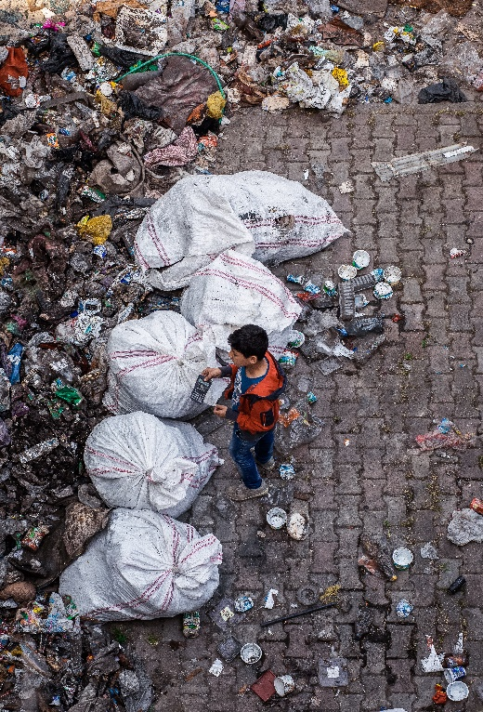
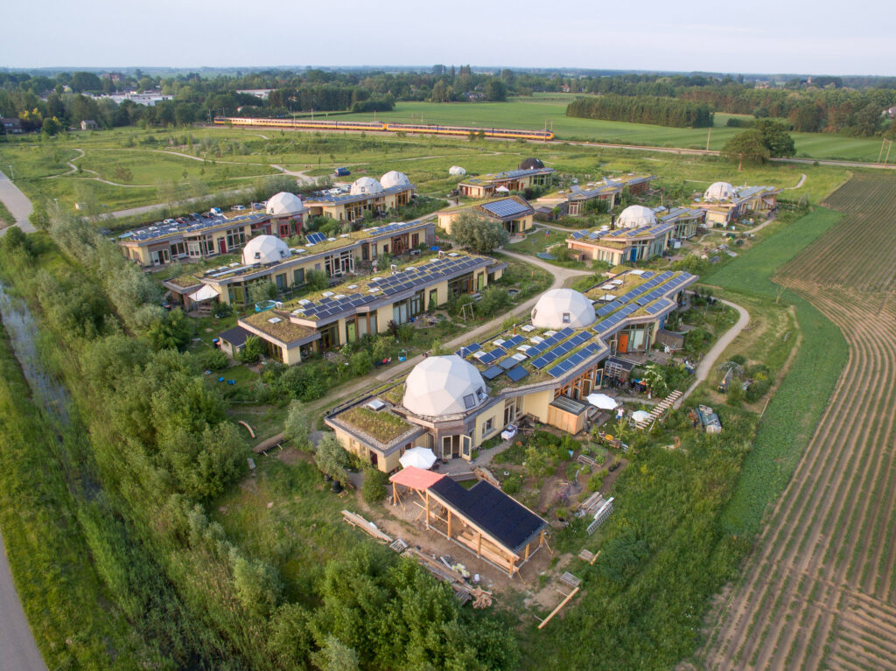
Transformative social innovation (TSI)
social innovations are
transformative to the
extent that they
challenge
alter
replace
dominant structures & power relations that underlie societal challenges
Aardehuis Olst, Netherlands, image by Florijn de Graaf
Photo by Chris LeBoutillier from Pexels
Pel et al. 2020
Avelino et al. 2019
Haxeltine et al. 2017
Photo by Emre Kuzu from Pexels

Slide 4




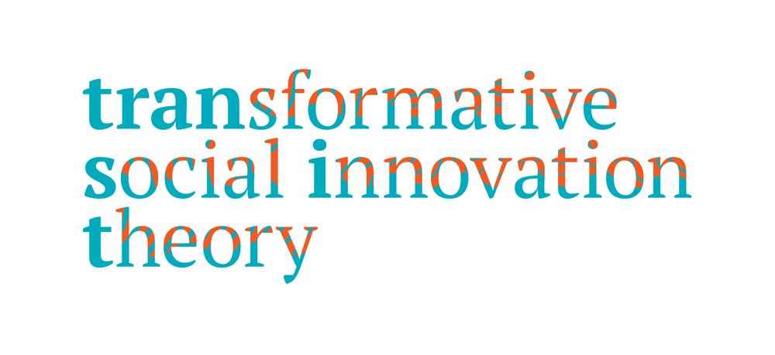
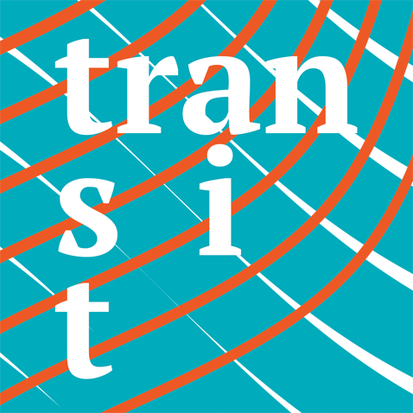





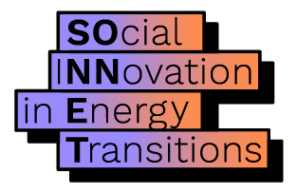

@FlorAvelino

Slide 5
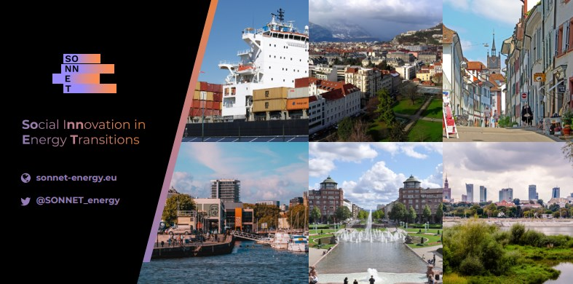
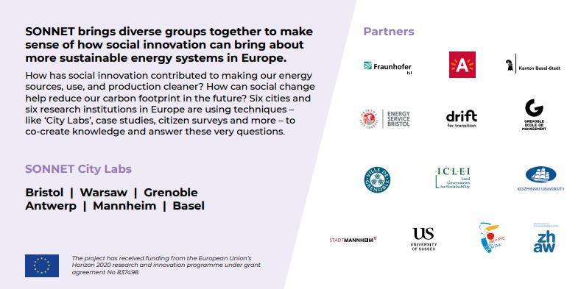

Slide 6
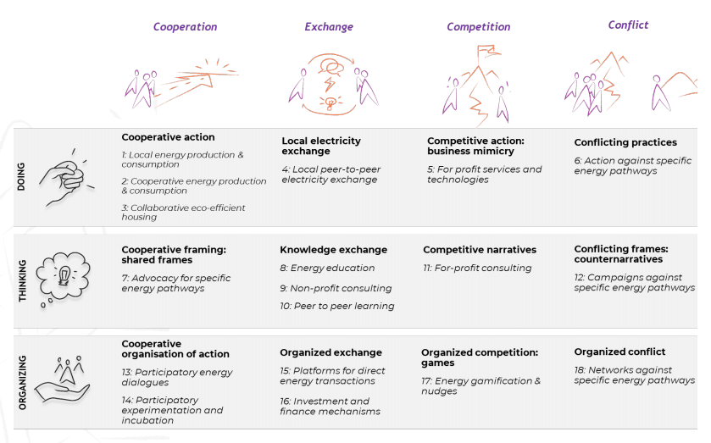
Typology of Social Innovation in Energy
Wittmayer et al. 2020

Slide 7
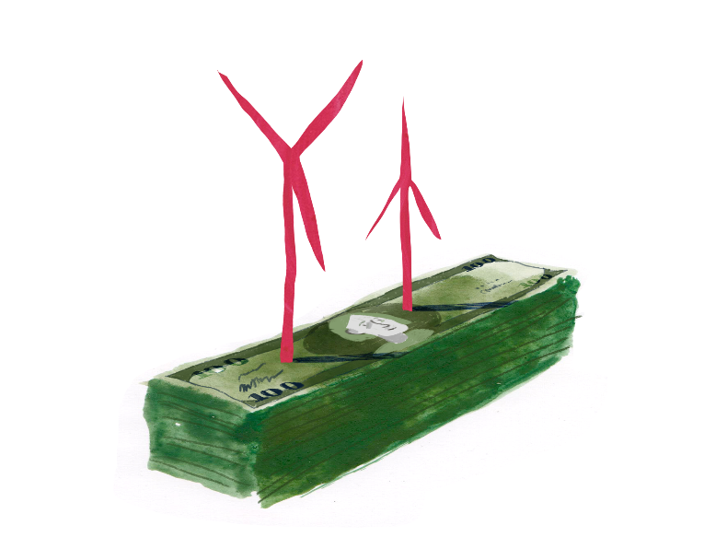

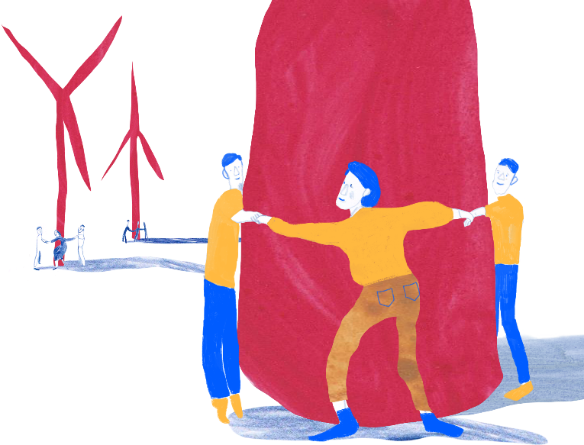
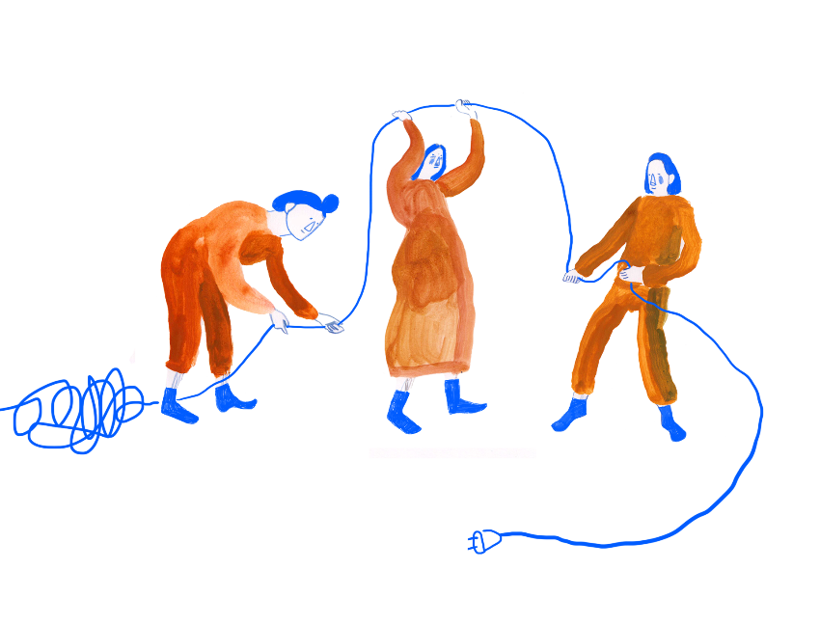
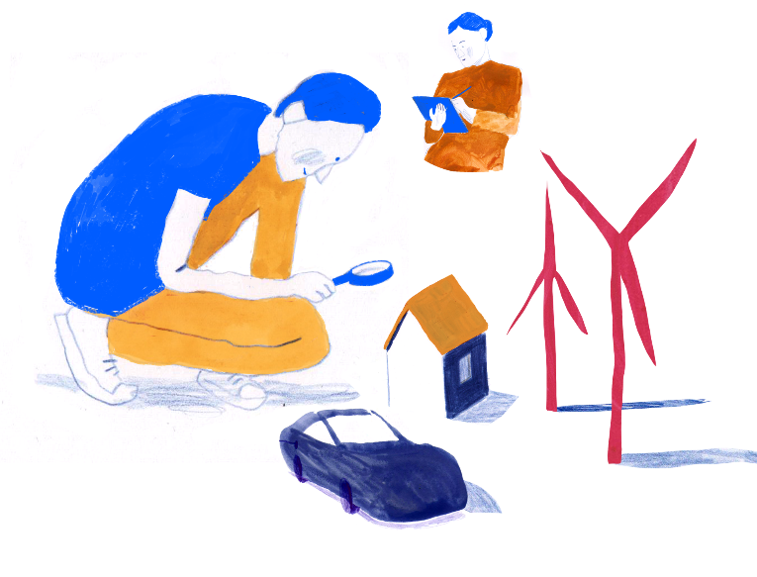
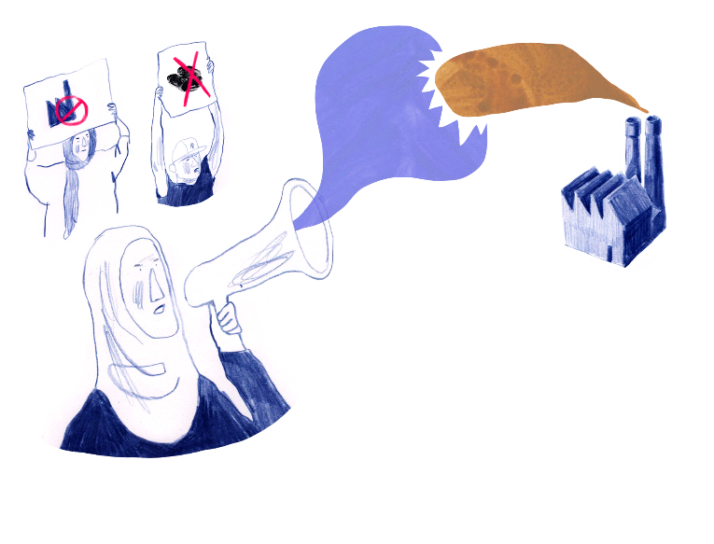
6 Social Innovation Fields
Cooperatives
Gamification & city-level competitions
Innovative financing
Framings against fossil fuel energy
Participatory incubation & experimentation
Local Electricity Exchange

Slide 8
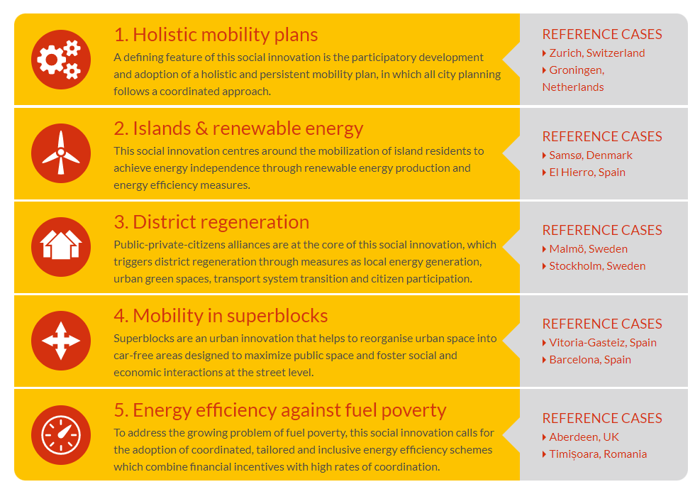
5 Social Innovation Clusters / Domains of Energy Transitions

Slide 9
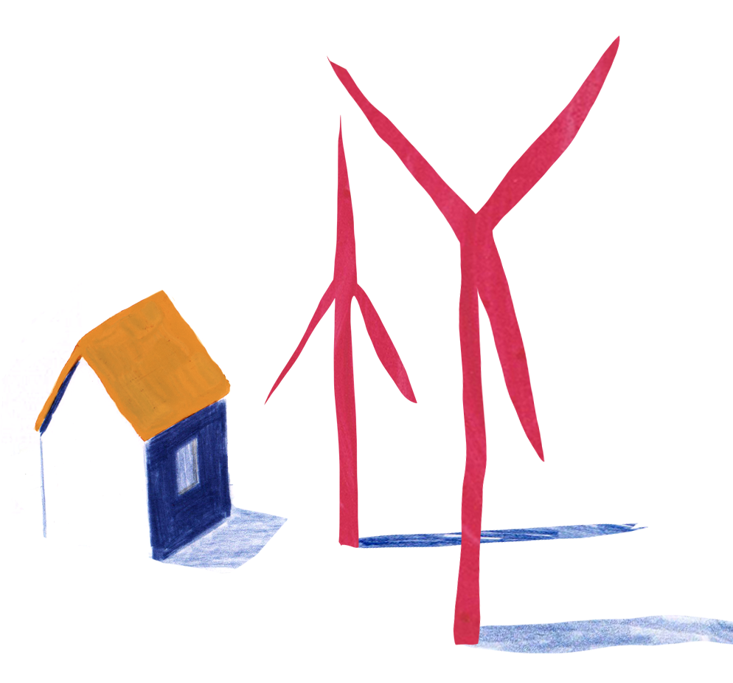
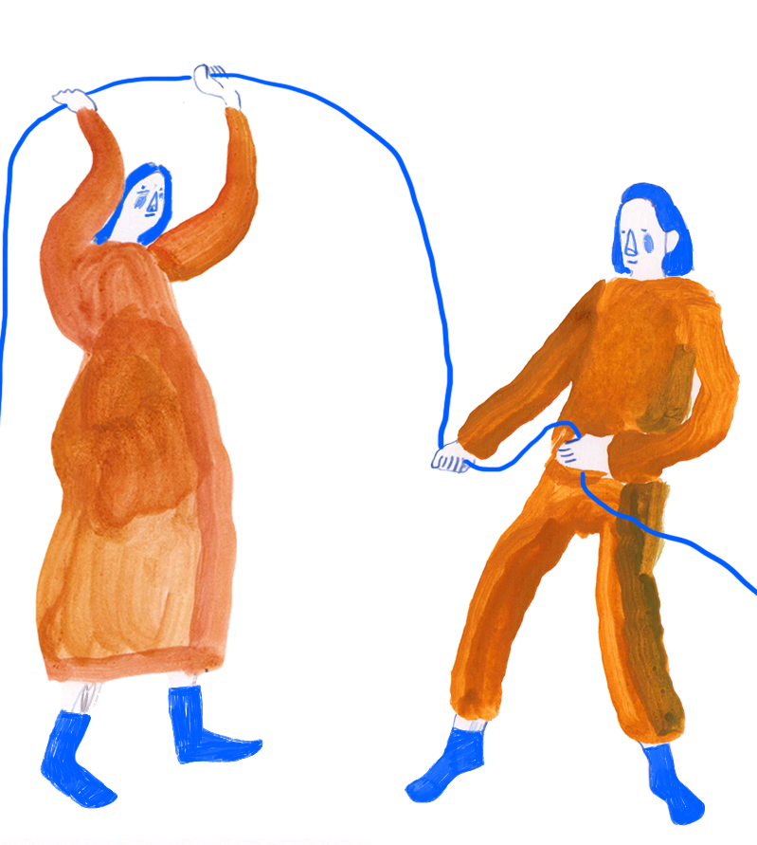
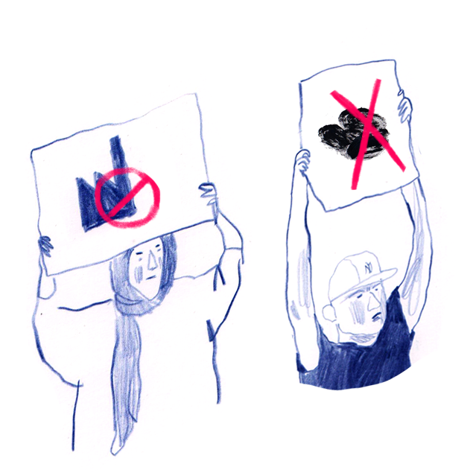
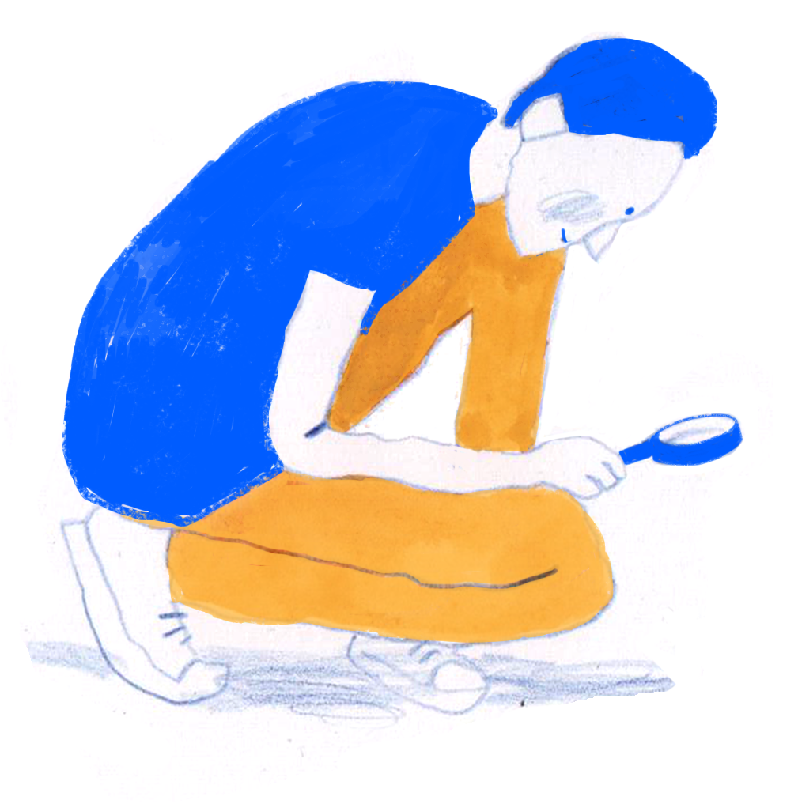


Transformative power
=
prefigurative power
capacity to prefigure new ways of doing, thinking & organizing
+
countervailing power
capacity to challenge & dismantle existing structures & institutions
+
reinforcive power
capacity to reproduce existing structures & institutions

Slide 10
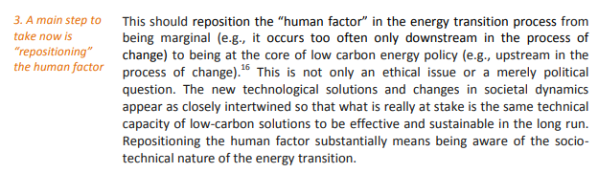
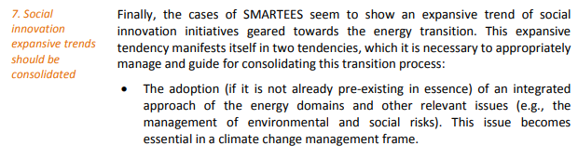
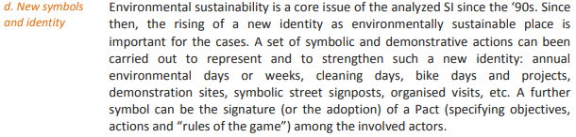

Synergies SI in energy & broader social movements
What are the synergies between social innovations in energy and wider social movements around just sustainability transitions, and (how) can the transformative potential of these synergies be increased? (incl. phasing out & letting go…)

Slide 11

Diverse institutional logics
Social innovations
in energy…
Emerge across diverse
institutional logics
Shifting (power) relations
& boundaries between
institutional logics
is - in itself - a form of
social innovation.
STATE
(public agencies)
formal
non-profit
informal
for-profit
H Y B R I D
public
private
NON-PROFIT
(NGOs, associations
foundations)
S P H E R E
COMMUNITY
(households, families etc.)
MARKET
(firms, business)
Avelino & Wittmayer 2016, 2019, Wittmayer et al. 2021, Based on Evers & Laville 2004, Pestoff 1992

Slide 12
Power imbalances
non-profit
for-profit
STATE
(public agencies)
public-private-partnerships
formal
PPP
informal
public
H Y B R I D
private
NON-PROFIT
(NGOs, associations
foundations)
S P H E R E
MARKET
(firms, business)
COMMUNITY
(households, families etc.)
Avelino & Wittmayer 2016, 2019, Wittmayer et al. 2021

Slide 13
Micro-politics: struggles, contestations, inequalities, hierarchies
STATE
national/
local
non-profit
formal
politicians/
civil servants
for-profit
informal
H Y B R I D
public
expert/
lay
private
ethnicities
NON-PROFIT
benefactor/
beneficiary
employer /
employee
S P H E R E
man/
woman
consumer/
producer
young/
old
poor /
rich
large /
small
COMMUNITY
MARKET
Avelino & Wittmayer 2016, 2019, Wittmayer et al. 2021

Slide 14
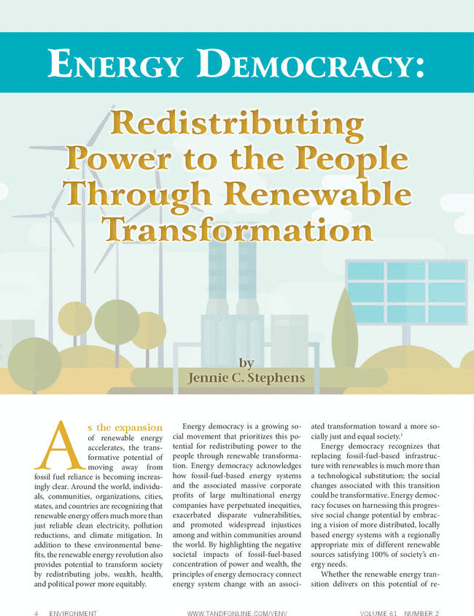
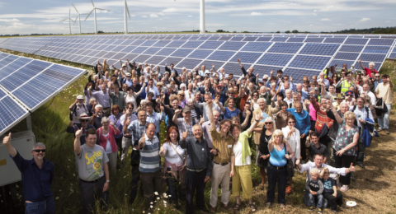
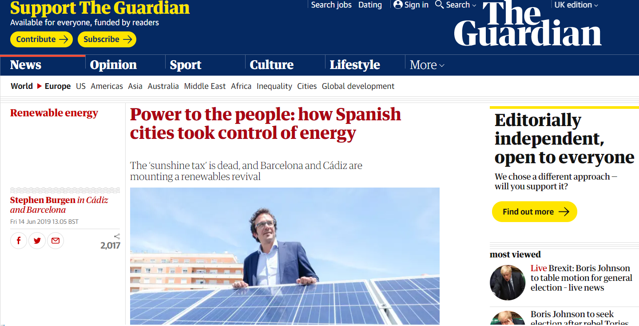
@FlorAvelino
Notes:
https://www.theguardian.com/environment/2019/jun/14/power-to-the-people-how-spanish-cities-took-control-of-energy?page=with:img-2
https://www.google.com/imgres?imgurl=http%3A%2F%2Fwww.foeeurope.org%2Fsites%2Fdefault%2Ffiles%2Fstyles%2Fnode_header_480%2Fpublic%2Fclimate_justice%2F2019%2Fimage002.png%3Fitok%3DCCxgfgW3&imgrefurl=http%3A%2F%2Fwww.foeeurope.org%2FEuropeans-gain-new-rights-to-produce-their-own-energy-191218&docid=m1C63UNgq47IYM&tbnid=IQLD9mAHzdFOIM%3A&vet=10ahUKEwiOqt3xgr_lAhULdJoKHavZCoQQMwhIKAUwBQ..i&w=480&h=260&bih=578&biw=1280&q=power%20to%20the%20people%20community%20energy&ved=0ahUKEwiOqt3xgr_lAhULdJoKHavZCoQQMwhIKAUwBQ&iact=mrc&uact=8

Slide 15
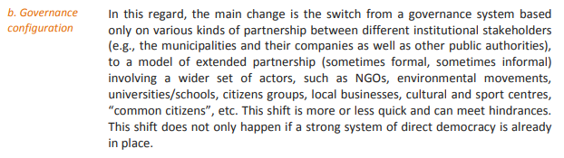
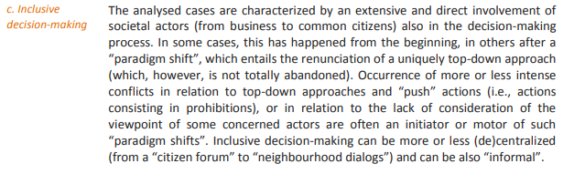
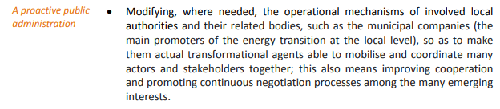
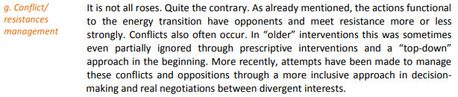
Multi-actor governance
How can multi-actor governance empower social innovations in energy transitions (without exacerbating problematic power relations)?

Slide 16
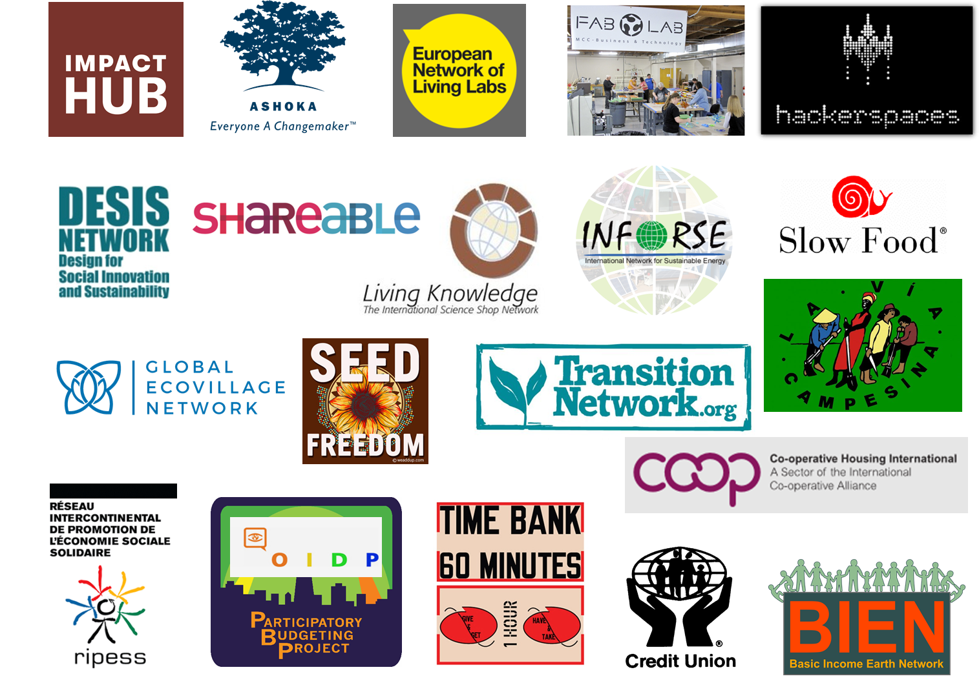
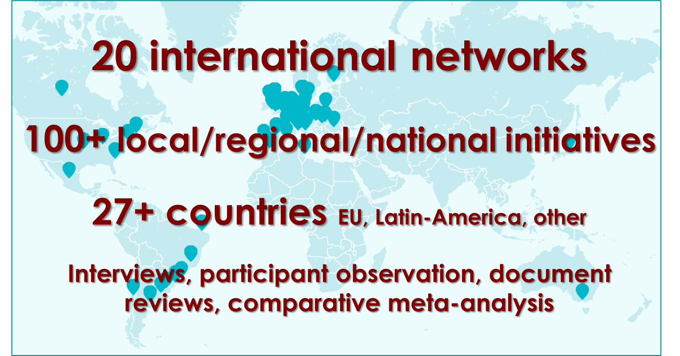
Longhurst et al. 2016
Søgaard Jørgensen et al. 2016
Monticelli 2018
Avelino et al. 2019
Wittmayer et al. 2019
Pel et al. 2020
www.transitsocialinnovation.eu/discover-our-cases-2
tsimanifesto.org

Slide 17
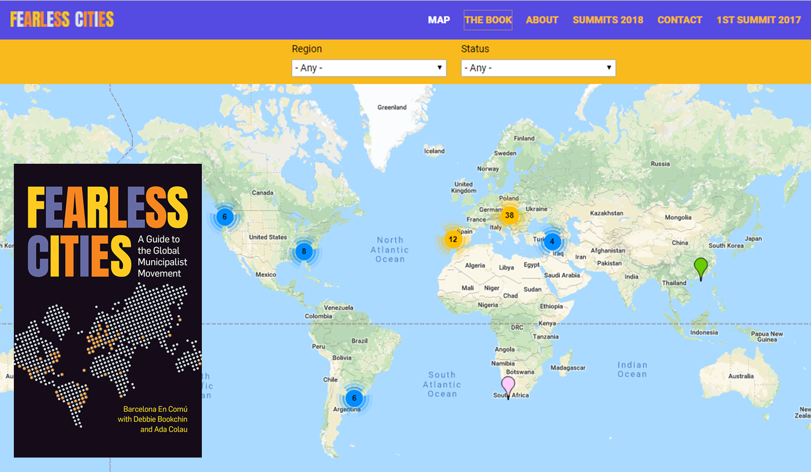
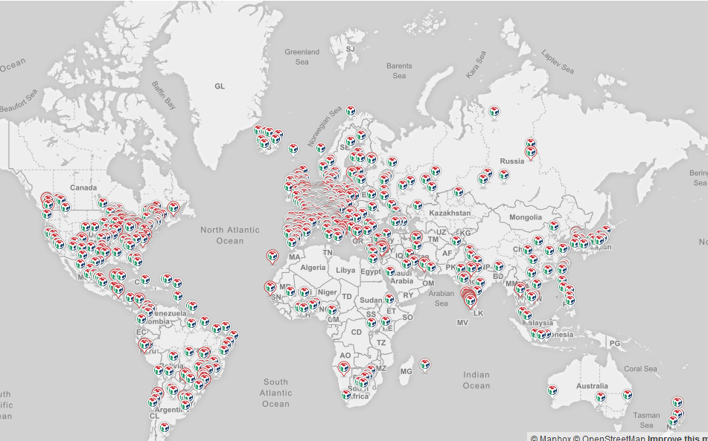
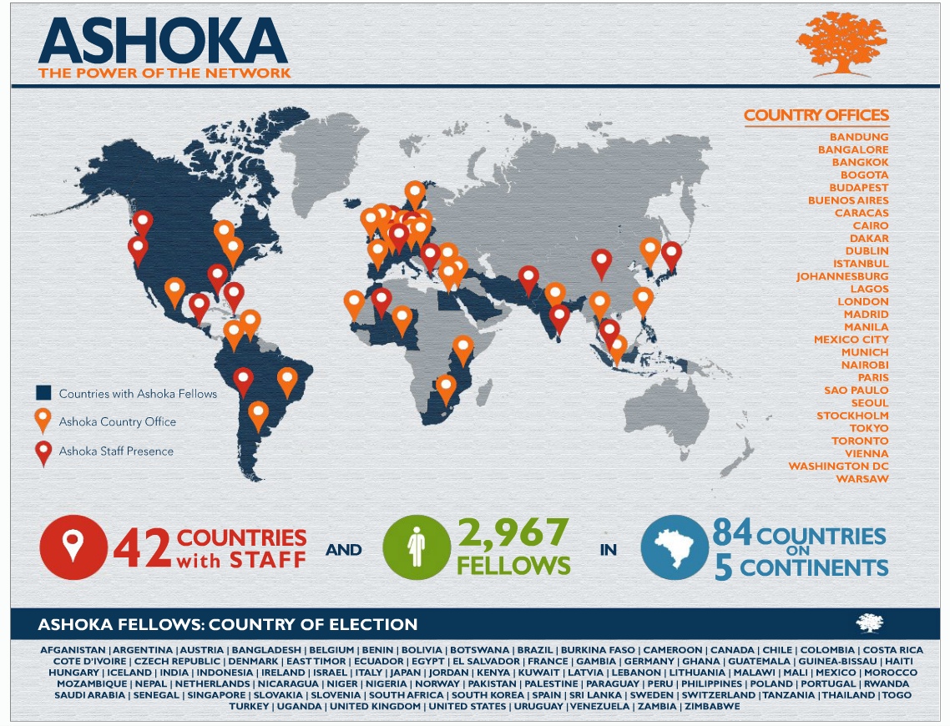

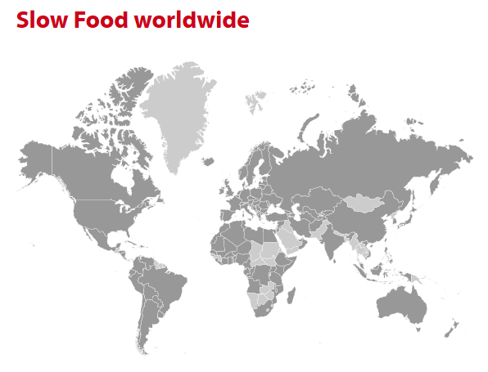

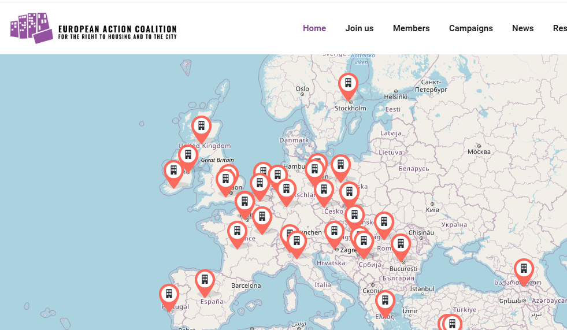
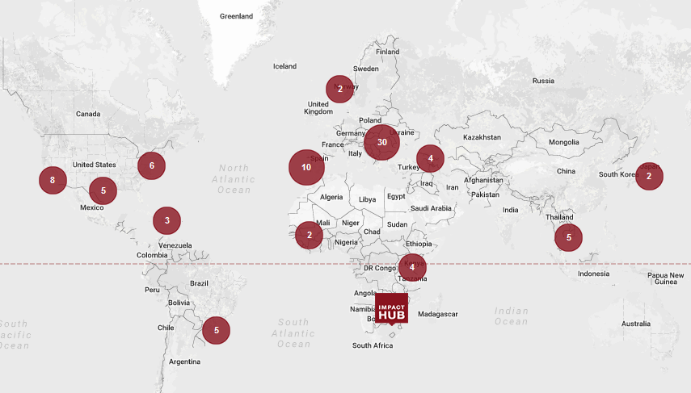

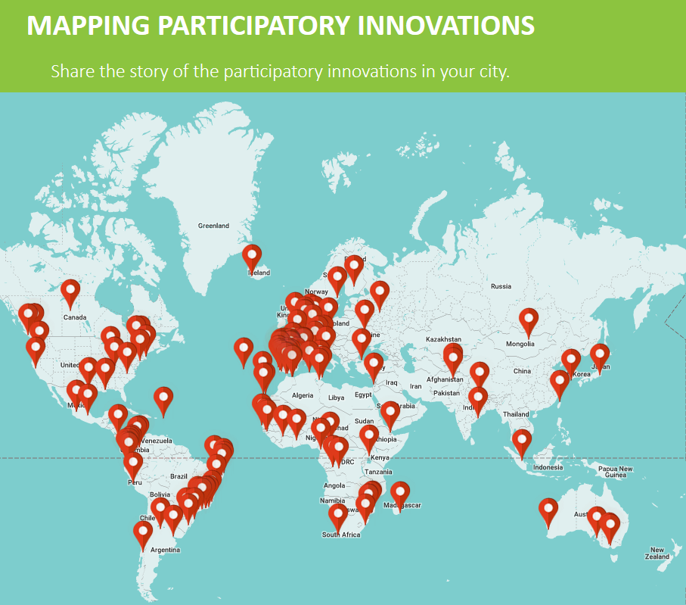
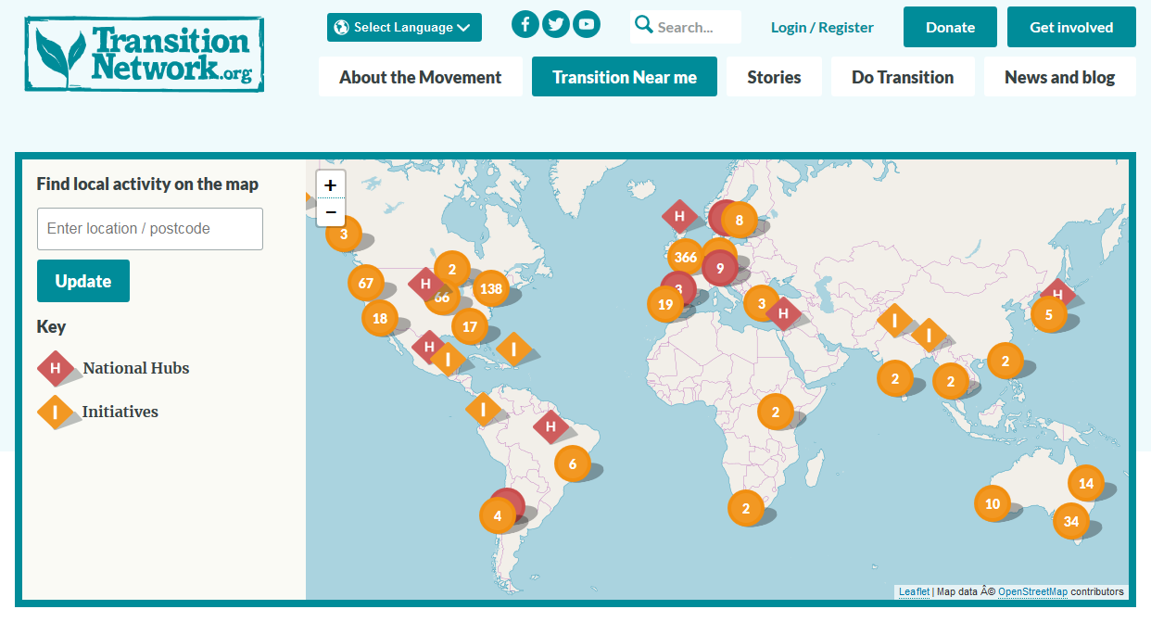
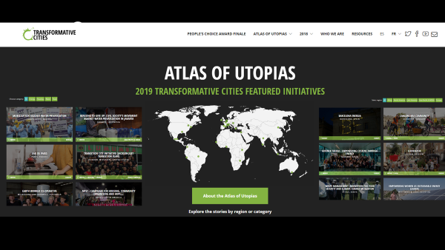
Translocal Empowerment
locally embedded as well as translocally connected
Avelino, Dumitru, Cipolla, Kunze & Wittmayer 2020, Loorbach et al. 2020

Slide 18

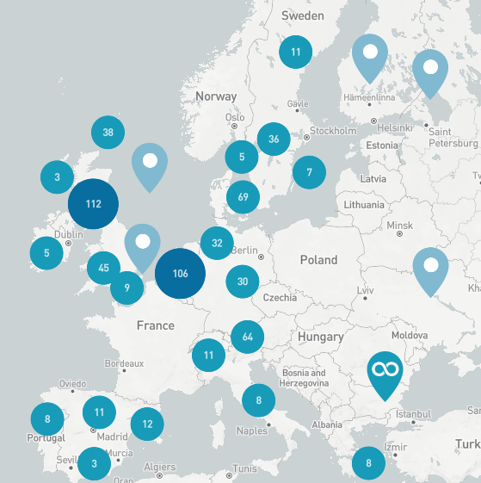




Notes:
b. Governance configuration
the main change is the switch from a governance system based only on various kinds of partnership between different institutional stakeholders (e.g., the municipalities and their companies as well as other public authorities), to a model of extended partnership (sometimes formal, sometimes informal) involving a wider set of actors, such as NGOs, environmental movements, universities/schools, citizens groups, local businesses, cultural and sport centres, “common citizens”, etc. This shift is more or less quick and can meet hindrances. This shift does not only happen if a strong system of direct democracy is already in place.

Slide 19
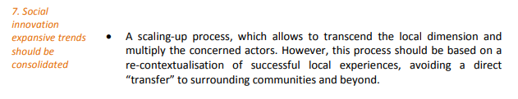
Translocal empowerment
How (people in) translocal multi-actor networks be empowered to contribute to social innovation for energy transitions?

Slide 20
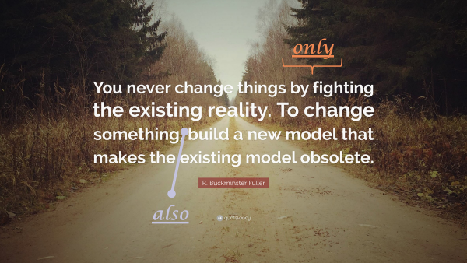
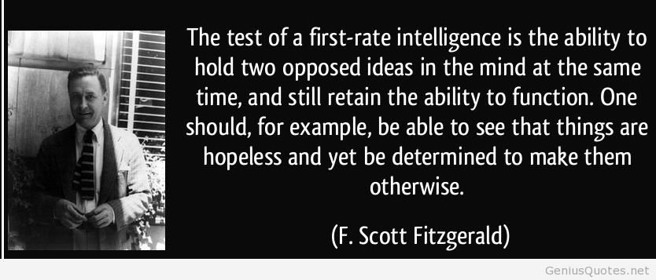




Thank you!
Dr. Flor Avelino
Erasmus University Rotterdam
avelino@drift.eur.nl
@FlorAvelino
@Alterotopia
@flor.avelino.5

