Slide 1
Aberdeen City
Fighting fuel poverty through energy efficiency
Mai Muhammad
Energy Manager
Aberdeen City Council
14th September 2021

Slide 2
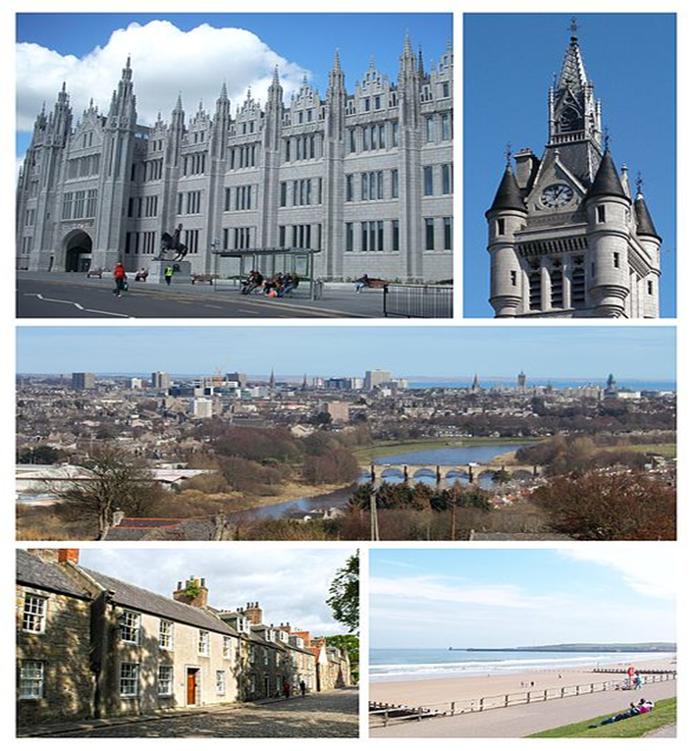
Aberdeen
Scotland's third most populous city. Since the discovery of North Sea Oil in the 1970s, Aberdeen has been known as the off-shore oil capital of Europe.
It's also known as the ‘Granite City’ for its many enduring grey-stone buildings.
Oceanic climate, Average annual temperatures 5C – 12C.

Slide 3
Fuel Poverty
In 2019 population of Aberdeen estimated at 228,670 and projected to grow by 28% by 2037. In 2016 there was 106,749 households in the City; it is projected that by 2037 there will be in excess of 140,000 households.
Fuel Poverty definition:
The 2019 Act establishes a new two-part definition whereby a household is considered fuel poor if:
after housing costs have been deducted, more than 10% (20% for extreme fuel poverty) of their net income is required to pay for their reasonable fuel needs; and
after further adjustments are made to deduct childcare costs and any benefits received for a disability or care need, their remaining income is insufficient to maintain an acceptable standard of living, defined as being at least 90% of the UK Minimum Income Standard (MIS).
Currently 23% of households in Aberdeen City are in fuel poverty and 5% are in extreme fuel poverty.

Slide 4
Torry – SMARTEES Project Area
Torry is a relatively large and quite tightly populated residential area, and majority of the housing stock is flats/apartment properties.​
The majority of housing in Torry is rented accommodation, with the most common landlord being the local authority. Around 4 in five households are social rented accommodation.
​Over recent years, there has been considerable investment and improvements to the housing stock with many houses benefiting from thermal upgrading
Housing is far more than bricks and mortar. Housing that is adequate is important for good health and wellbeing. Poor quality housing can lead to increased health risks and can exacerbate many existing health conditions.​
As a result of the current pressures on the jobs market in Aberdeen, it is possible that fuel poverty in the city will rise as incomes reduce.

Slide 5
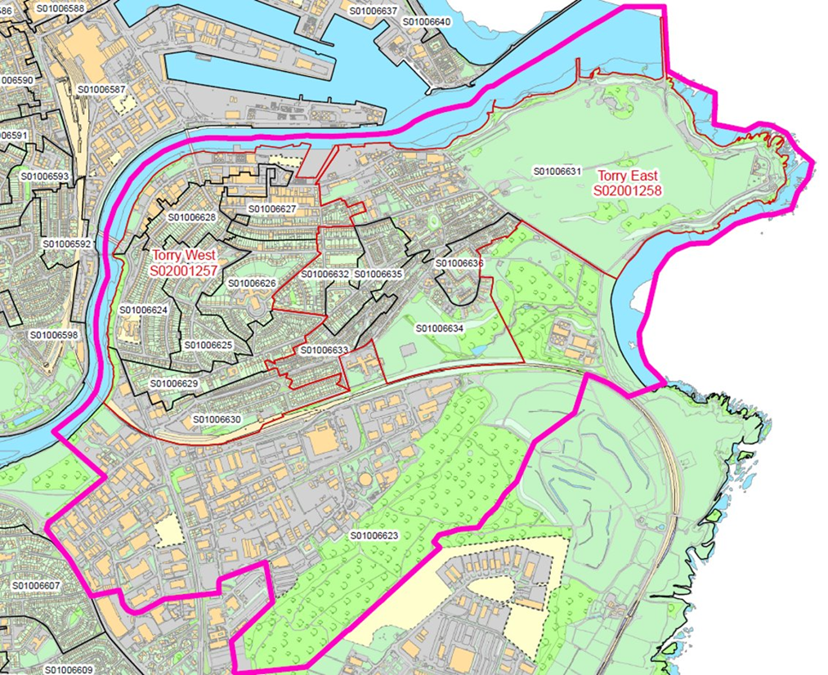
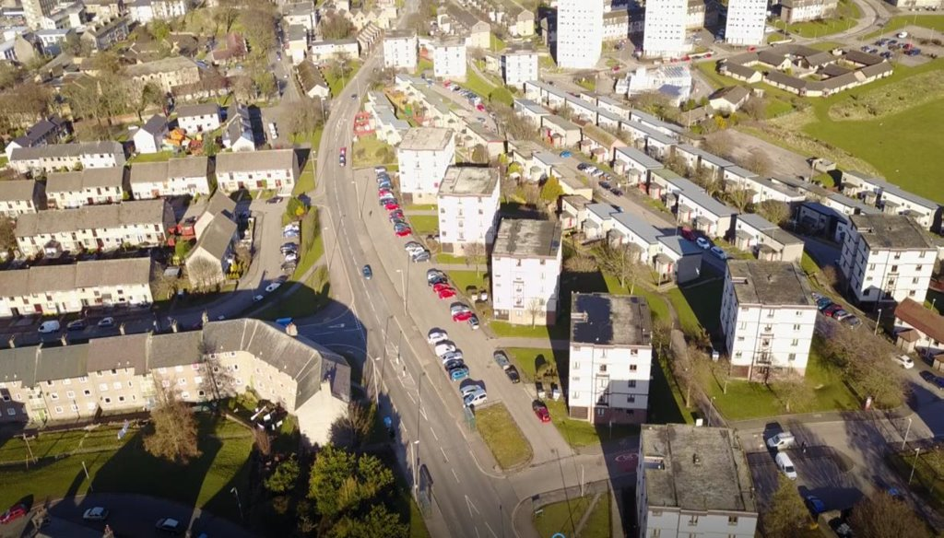
Torry - SMARTEES Project Area

Slide 6
District Heating Opportunity
Aberdeen City Council is working in partnership with two other neighbouring local Authorities is building a new Energy from Waste (EfW) with 10MW heat output near Torry. By 2024, the plant, will generate heat and power and will have the ability to provide secure, low cost energy to households, businesses and council buildings, potential to reduce fuel poverty.
Aberdeen City has an established district heating company, Aberdeen Heat & Power which has been developing heat networks in Aberdeen while alleviating fuel poverty since 2002.
Aberdeen City Council also has partnership with social enterprise, SCARF who have affordable warmth and energy efficiency at its core. SCARF is a trusted, impartial energy advice service provided to the citizens of Aberdeen for free.
In order to maximise the benefit of district heating, it is important to maximise the number of households connecting to the heat network.

Slide 7
Aberdeen Policy Sandbox Tool
To inform which areas will be able to maximise benefit of district heating by modelling the uptake of district heating connections.
These connections are influenced by cost of connection, cost of heat, financial circumstances, “green” awareness, social and community engagement.
The tool will show the influence of the actors, Aberdeen City Council (local authority), SCARF (social enterprise) and Aberdeen Heat & Power (district heating company) on the positive outcomes.
By identifying the key actors and policies which influence the outputs from the tool, the tipping points can be measured.
The tool will inform on the intensity of the influence which will result in a positive outcome.

Slide 8
Aberdeen Policy Sandbox Tool
Using social innovation modelling developed by JHI and SMARTEES, Aberdeen City Council along with the actors, will be able to model, predict and project outputs by modelling scenarios.
The tool will inform the Council on which policies will need further development to create positive impact on social acceptance of district heating.
The tool will help Aberdeen in expanding the district heating network throughout the city, beyond Torry

Slide 9
Aberdeen – District Heating Network

Slide 10
Thank you!
Stay in touch!
Mai Muhammad
mmuhammad@aberdeencity.gov.uk
www.local-social-innovation.eu

