Slide 1
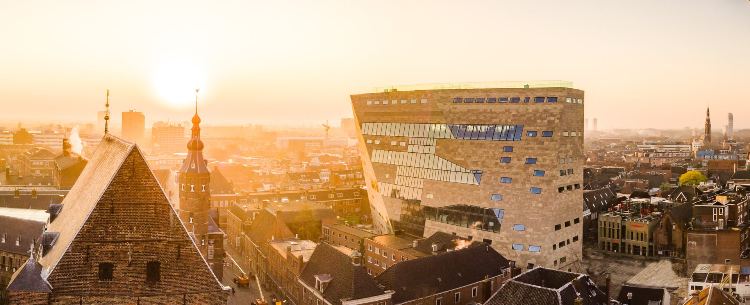

Holistic mobility planning in Groningen
Terry Albronda
City of Groningen, 14.09.2021

Slide 2
All you ever wanted to know about Groningen
Population: 230.000
Student city: 1 in 4 inhabitants
Age: 50% of population under 35
Compact city
Economic engine of the North

Slide 3
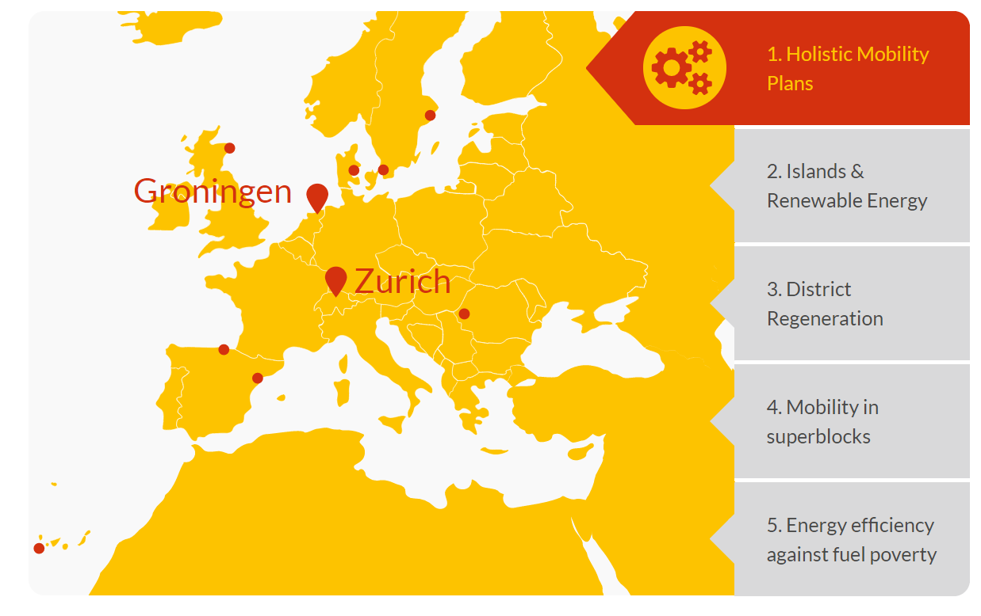
Cluster 1: Zurich & Groningen

Slide 4
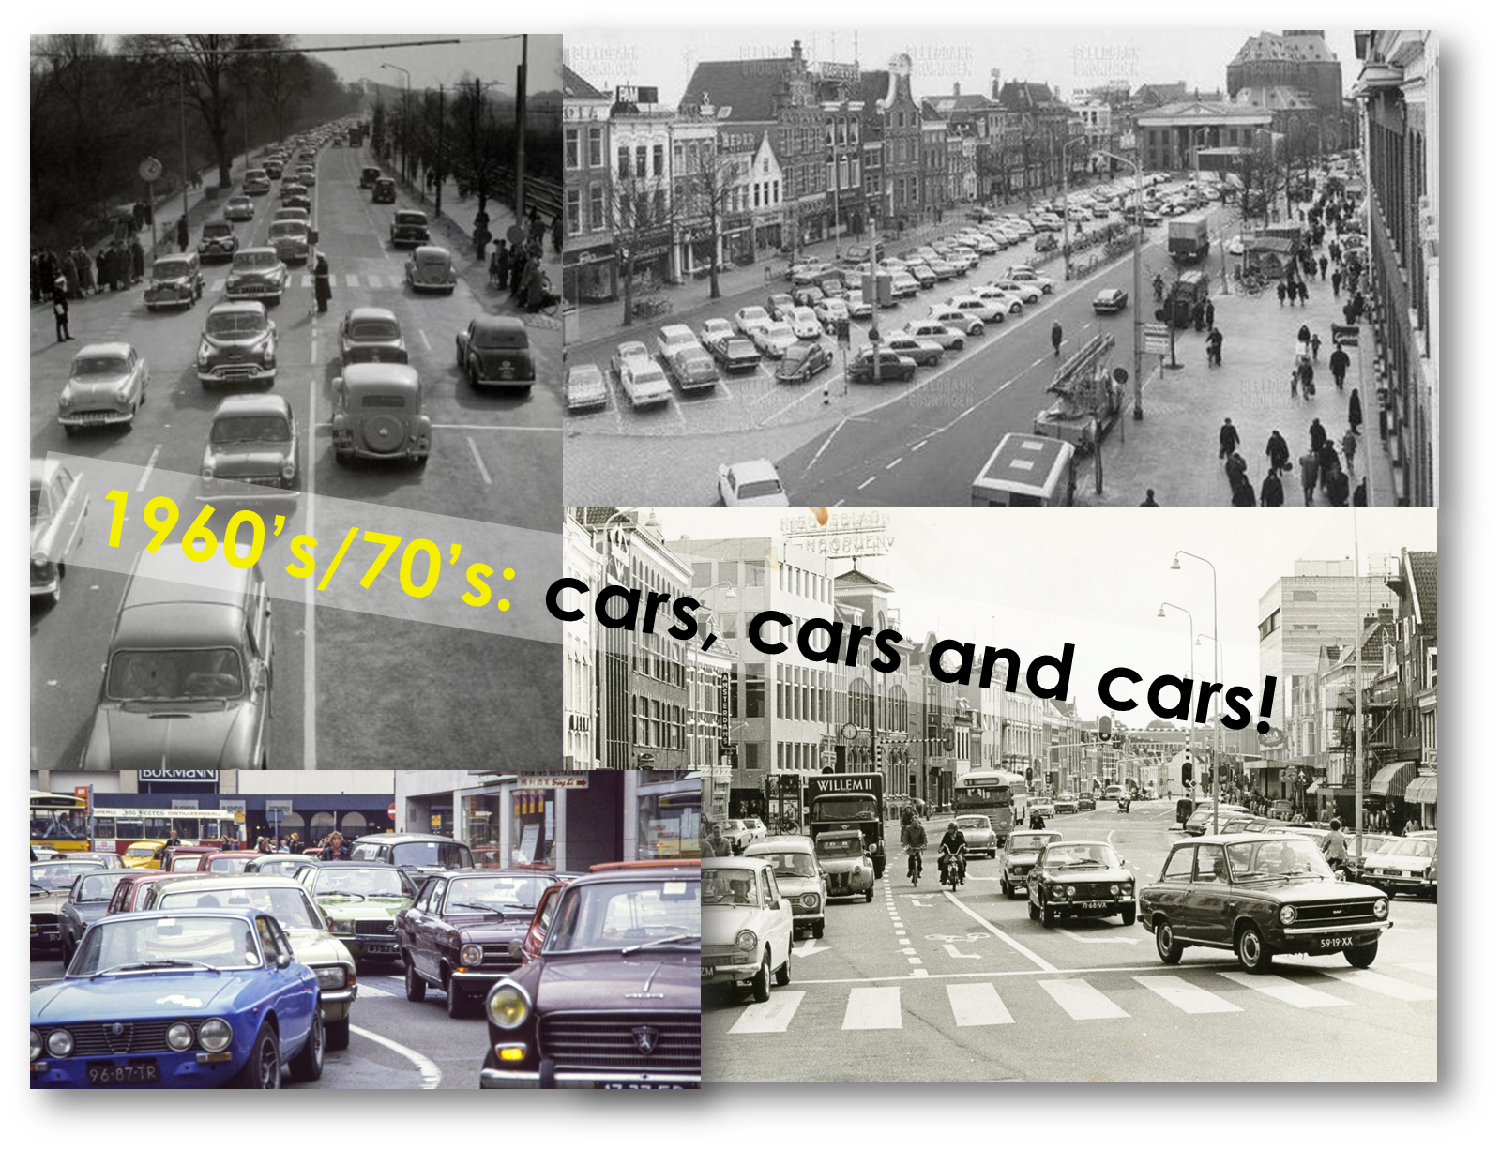
Our mobility transition started in the 70’s

Slide 5
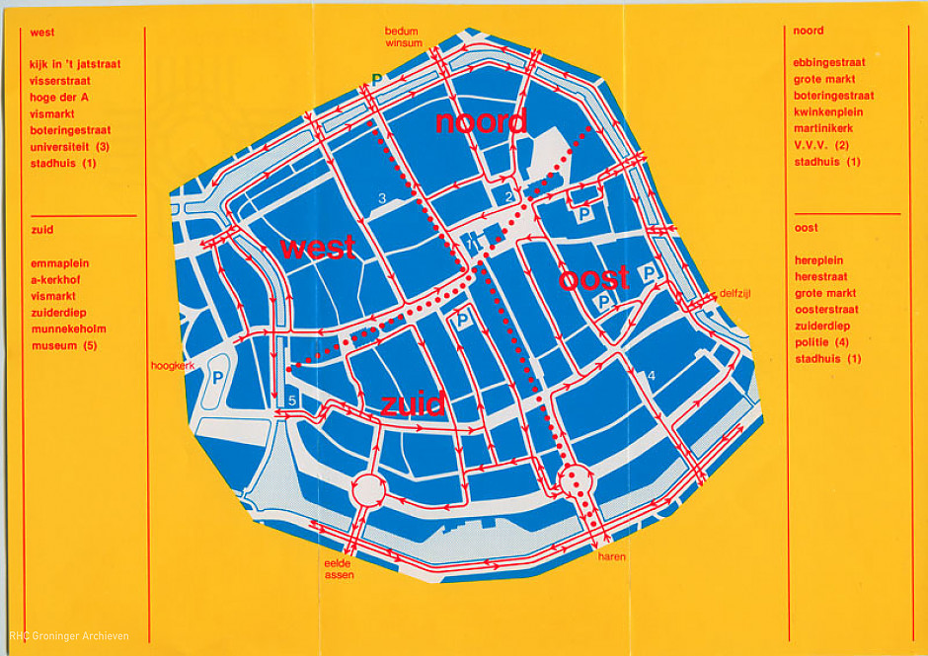
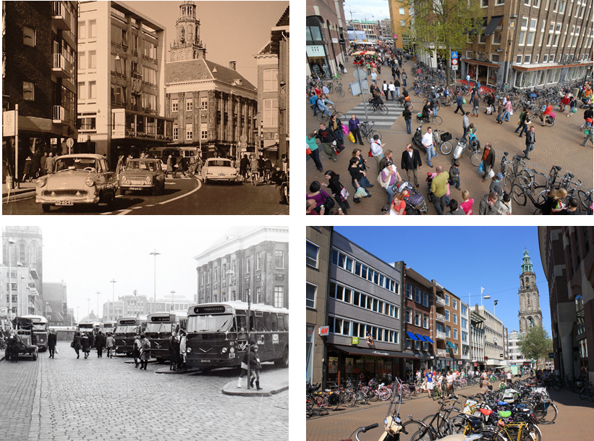
How Groningen became active travel friendly
Traffic Circulation Plan, 1977

Slide 6
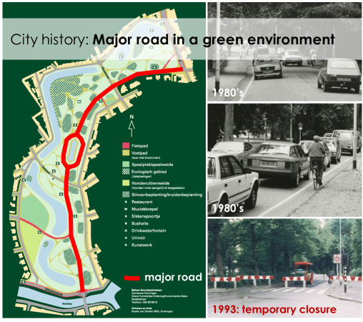
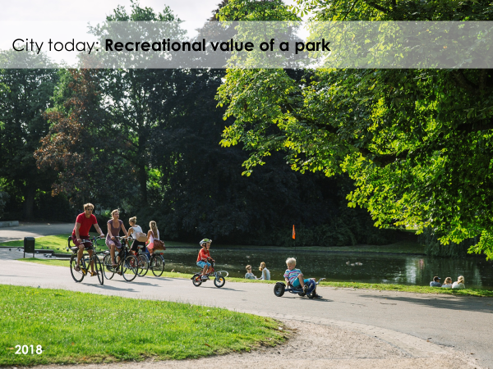
How Groningen became active travel friendly
Closing the park for car traffic, 1993

Slide 7
Next Generation SUMP (2021)
Mobility challenge
Direction change
Regaining public space on traffic
1. Choosing for living environment
Reduction of the dominance of (car) traffic in public space
Transport without CO2 emissions and air pollution and less noise
2. Changing travel behavior
Transition to less, space efficient, clean and healthy transport
Excellent accessibility for everyone

Slide 8
Democratic renewal
We want to break through the traditional sectoral approach of the government. The scale of neighborhoods and villages is the most suitable for this. It is also precisely here that the management of residents can be strengthened and their control can be increased.
We experiment with far-reaching control and direction by the neighborhood and village communities.
Coalition agreement 2019-2022
Healthy, Green, Happy Groningen
Our ambition is sustainable democratic renewal and an integral area-oriented way of working in the city as a whole, in all neighborhoods and villages.

Slide 9
Area oriented
cooperation works!
proximity to the municipal administration
a visible and easily approachable area team that builds confidence
the deployment of expertise at the service of the process
the area team ensures integrality and is the face and link in the cooperation per neighborhood
work according to local logic

Slide 10
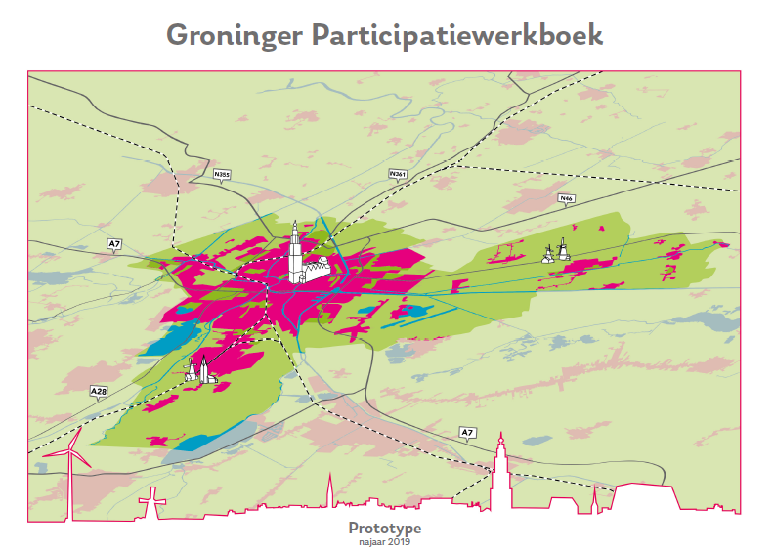
The Groninger
Participation Workbook
The responsibility for participation no longer always rests with the government!
The Action Plan
Prepairing participation
Our values
Playing Cards

Slide 11
A change of position of the government
government
government
past
present
future

Slide 12
From Factor C to Factor D
the art of connecting, letting go and grasping
residents logic
initiate and direct
stimulate and let go
residents respond
to plans
society does
it together
right at the
municipality
right with
society
municipality makes
plans and executes
residents perform
municipal tasks
initiate and adjust
facilitate and tune
municipal logic

Slide 13
Holistic mobility planning in Groningen
Terry Albronda
City of Groningen, 14.09.2021

